Slide 1

CubicWeb – The Semantic Web is a construction game!
University of Belgrade
School of Electrical Engineering
Department of Computer Engineering
Student: Uglješa Milić
Email: mu113322m@student.etf.rs
Belgrade,
December 2011

Slide 2
Agenda
About CubicWeb
Basic terms
Example
Conclusion
Q&A
1/16

Slide 3

About CubicWeb
Open source, semantic web application framework
Written in Python
Based on two major things:
- reusable components (cubes)
- well known object-oriented design principles
2/16

Slide 4
About CubicWeb
Its main features are:
an engine driven by the explicit data model
a query language named RQL similar to W3C’s SPARQL
a selection/view mechanism for representation
a library of reusable components (data model and views)
the power and flexibility of the Python language
the reliability of various databases for storage backends
3/16

Slide 5
Basic terms
Cubes
A cube is a software component made of three parts:
- its data model (schema)
- its logic (entities)
- its user interface (views)
Data Repository
The data repository encapsulates and groups an access to one or more data sources
All interactions with the repository are done using the RQL
4/16

Slide 6
Basic terms
Schema (Data model)
Described as an entity-relationship schema
Views
Objects with a dedicated interface to ‘render’ something
Partitioned into different kind of objects such as templates, boxes, components…
Entity type
Entity type
Relation type
Subject
Object
Relation definition
5/16

Slide 7
Example
Installation comes with some already defined cubes (file, folder, login, blog…)
Example based on blog cube
Two goals:
- discovering the default user interface
- basic extending and customizing the look and feel
6/16

Slide 8
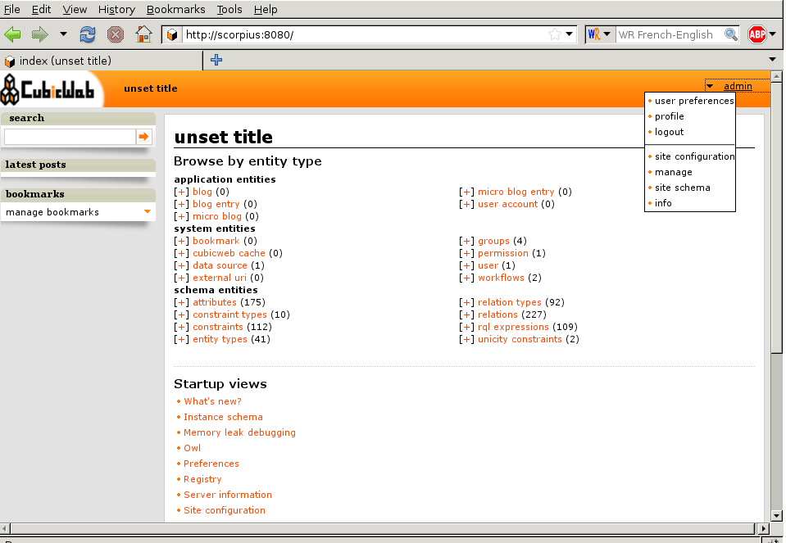
Example
The default index page
7/16

Slide 9
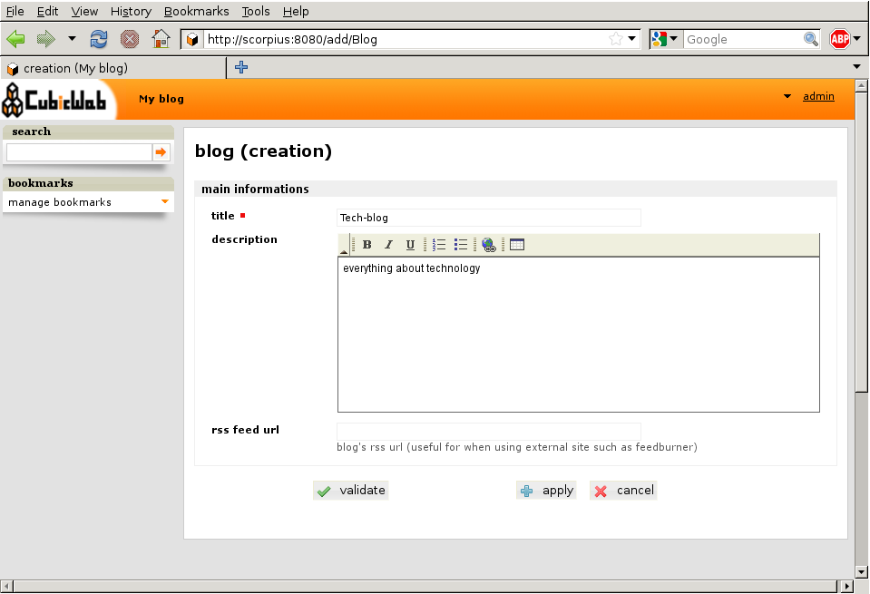
Example
Adding a blog
8/16

Slide 10
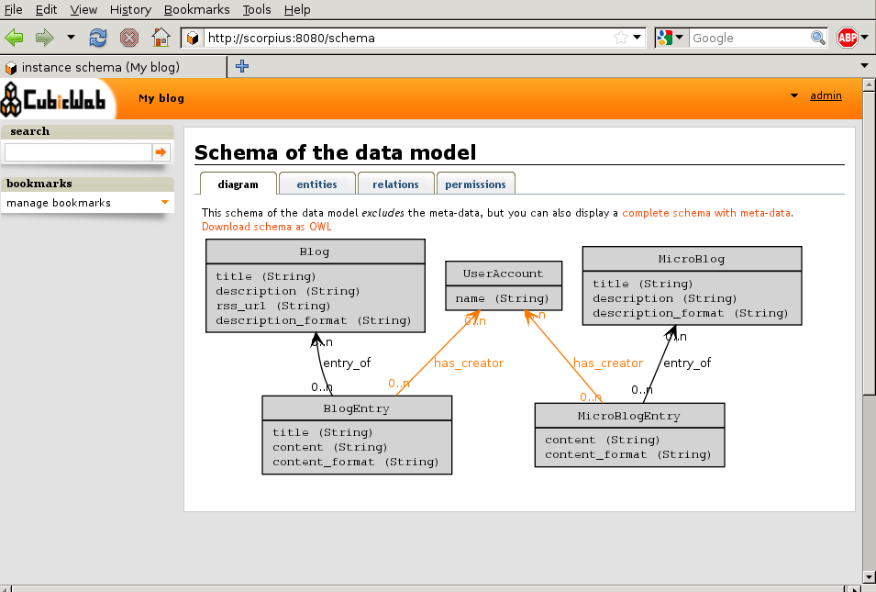
Example
Site schema
9/16

Slide 11
Example
Further customization – creating your own cube
Cube metadata
- in file __pkginfo__.py modify __depends__ dictionary
__depends__ = { 'cubicweb': '>= 3.10.7',
'cubicweb-blog': None}
10/16

Slide 12
Example
Extending data model
- in file schema.py of the cube
from yams.buildobjs import EntityType, RelationDefinition, String, RichString
class Community(EntityType):
name = String(maxsize=50, required=True) description = RichString()
class community_blog(RelationDefinition):
subject = 'Community'
object = 'Blog'
cardinality = '*?'
composite = 'subject'
11/16

Slide 13
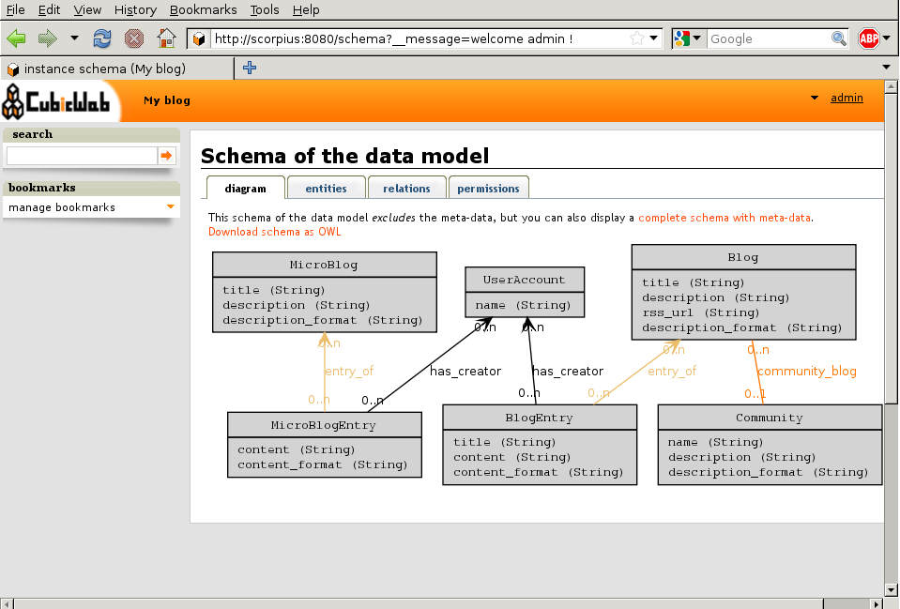
Example
New site schema
12/16

Slide 14
Example
Further extending
from yams.constraints import StaticVocabularyConstraint class visibility(RelationDefinition):
subject = (‘Blog’, ‘MicroBlog’)
object = 'String'
constraints = [StaticVocabularyConstraint (('public', 'authenticated', 'restricted', 'parent'))]
default = 'parent'
cardinality = '11’
class may_be_read_by(RelationDefinition): __permissions__ = {
'read': ('managers', 'users'),
'add': ('managers'),
'delete': ('managers') }
subject = (‘Blog’, ‘MicroBlog’)
object = ‘Community'
13/16

Slide 15
Conclusion
Framework entirely driven by a data model
Based on reusable components and object-oriented programming principles
Supports OWL and RDF
View/selection principle
14/16

Slide 16
References
CubicWeb – The Semantic Web is a construction game, [online] Available at: <http://www.cubicweb.com> [Accessed 22 December 2011]
15/16

Slide 17
Q&A
16/16

